Slide 1

THE SUPREME YOGA
AND THE SCIENCE OF SUGGESTION
Bridging the Yoga Vāsiṣṭha and Modern Hypnotherapy Through Consciousness, Narrative, and Neuroscience
Luis Miguel Gallardo
Yogananda School of Spirituality and Happiness
Shoolini University, Himachal Pradesh, India
World Happiness Foundation Research Lab · September 2026
doi.org/10.68220/whf.2026.001
Notes:
Paper: Gallardo, L. M. (2026). The Supreme Yoga and the Science of Suggestion. World Happiness Foundation Research Lab. DOI 10.68220/whf.2026.001.
Illustration: original image generated for this presentation.
Opening prompt: The paper asks whether a classical Indian psychology of constructed experience can inform an empirically testable clinical model without reducing either tradition to the other.

Slide 2
A proposed bridge across three domains
01
02
03
SOURCE TEXT
CLINICAL SCIENCE
RESEARCH PROGRAMME
Yoga Vāsiṣṭha
Hypnosis
YVH
Mind as world-maker
Narrative as pedagogy
Liberation while living
Focused attention
Absorption and expectancy
Strategic suggestion
Construct concordance
Defined clinical pathway
FP20 and five hypotheses
Academic position
YVH is presented as an India-rooted, culturally accountable and empirically testable model. No YVH clinical trial has yet been conducted.
Source: Gallardo (2026), Abstract and Sections 1, 5, 10 and 11.6
02
Notes:
Central thesis: YVH links Yoga Vāsiṣṭha constructs with hypnosis science through a proposed protocol and outcome measure. Use the verbs proposes and hypothesizes. The cited clinical evidence supports hypnosis, not YVH.
Sources: Gallardo (2026), Abstract and Sections 1, 5, 10 and 11.6.

Slide 3
Yoga Vāsiṣṭha as a psychology of transformation
OPERATIVE IDEA
The seven jñāna-bhūmikās
Experience is shaped by mind, sustained by latent patterns, and transformed through inquiry, imagination and self-effort.
7
Turyagā
Stable liberation
6
Padārthābhāvanā
Objects no longer felt as separate
5
Asaṃsakti
Non-attachment in action
The text culminates in jīvanmukti: freedom while fully engaged in life.
4
Sattvāpatti
First direct realization
3
Tanumānasā
Thinning of habitual mind
2
Vicāraṇā
Textual caution
Sustained inquiry
The received Yoga Vāsiṣṭha has a complex recension history. The stage map is contemplative and developmental.
1
Śubhecchā
Desire for truth
Sources: Slaje (2000), Hanneder (2009), Venkatesananda (1993), Atreya (1936)
03
Notes:
The paper describes a medieval Kashmiri core with later expansion. The seven stages move from the desire for truth through inquiry and thinning of habitual mind to stable liberation. These are cumulative contemplative stages, not trance levels.
Sources: Gallardo (2026), Sections 2.1 to 2.4; Slaje (2000); Hanneder (2009); Venkatesananda (1993); Atreya (1936).

Slide 4

Story as an intervention
The paper’s core reading:
the stories do not merely describe transformation — they enact it.
THE CŪḌĀLĀ METHOD
01
Meet the learner within their frame
02
Teach through indirect narrative
03
Test attachment through experience
04
Withdraw guidance as insight stabilizes
Five clinical tales examined in the paper: Līlā, Lavaṇa, Gādhi, Bhuśuṇḍa and Cūḍālā.
Sources: Ganesathasan (2004), Venkatesananda (1993), Gallardo (2026), Section 2.6
04
Notes:
The paper treats five narratives as phenomenological experiments. Cūḍālā becomes the clearest clinical analogue because her staged intervention works within the learner's own frame and returns agency after realization stabilizes. The comparison with Ericksonian therapy remains interpretive.
Sources: Gallardo (2026), Section 2.6; Ganesathasan (2004); Venkatesananda (1993).
Illustration: original image generated for this presentation.

Slide 5
India in the history of hypnosis
The paper reframes the history as restitution: recovering Indian people, places and knowledge without obscuring colonial power.
1819
1845–46
1850
GOA ORIGIN • PARIS PUBLICATION
BENGAL CLINICAL WORK
LAHORE REPORT • LONDON PUBLICATION
Abbé Faria
James Esdaile
Braid reads Haridas
Located hypnotic power in the subject's attention, expectancy and susceptibility.
Built a major early corpus of trance medicine under ethically troubled colonial conditions.
Braid interpreted samādhi reports through focused attention and physiology.
Historical care
The lineage concerns knowledge. It does not endorse the conditions under which colonial medicine produced some of its evidence.
Sources: de Faria (1819), Roberts (2016), Ernst (1995), Chakraborty (2024), Braid (1850)
05
Notes:
Faria, born in Goa, rejected Mesmer's magnetic fluid and placed the capacity in the subject. Esdaile's Bengal record must be discussed with colonial consent and power asymmetries visible. Braid's engagement with the Haridas reports belongs to a critical reception history, not proof of suspended animation.
Sources: Gallardo (2026), Section 3; de Faria (1819); Roberts (2016); Ernst (1995); Chakraborty (2024); Braid (1850).

Slide 6

Modern hypnosis: evidence and neural correlates
CLINICAL EVIDENCE
The strongest support concerns pain. Evidence also covers anxiety and selected clinical uses.
REPORTED PROCESSES
Focused attention
Absorption and expectancy
Suggestion that alters experience
NEURAL FINDINGS
ACC, prefrontal and salience systems, plus default mode network connectivity. Findings vary by task and individual.
Evidence supports hypnosis. Neural observations remain heterogeneous and correlational.
Sources: Rosendahl et al. (2024), Oakley et al. (2013), Jiang et al. (2016), Wolf et al. (2022)
06
Notes:
Distinguish evidence for hypnosis from evidence for YVH. Avoid treating any single region or EEG band as a marker of a contemplative stage. The paper identifies ACC, prefrontal regions, DMN modulation and altered connectivity as recurring findings.
Sources: Rosendahl et al. (2024); Oakley et al. (2013); Jiang et al. (2016); Wolf et al. (2022); De Benedittis (2021).
Illustration: original image generated for this presentation; it is conceptual, not anatomical evidence.

Slide 7
Complementarity without collapse
REDUCTION
COMPLEMENTARITY
INFLATION
The tradition becomes a technique stripped of its framework.
A clinical outcome receives metaphysical significance it cannot bear.
Difference
defines the
limits
01
02
03
04
05
Textual fidelity
Each mapping states its limits
Clinical or neural anchors
A defined procedure and outcome
Cultural integrity
Source: Gallardo (2026), Section 5
07
Notes:
The method protects both traditions from two familiar errors. Reduction turns the source tradition into a decontextualized technique. Inflation turns therapy into a spiritual attainment. The five rules discipline every correspondence and make the synthesis testable.
Source: Gallardo (2026), Section 5.

Slide 8
Four proposed functional bridges
Yoga Vāsiṣṭha
Clinical science
Proposed functional bridge
māyā / saṅkalpa
Constructed experience
Models of the world actively shape perception and can be revised.
bhāvanā
Absorption
Focused imaginative involvement makes experience more responsive to change.
teaching narrative
Therapeutic narrative
Stories reorganize meaning and open alternative responses.
vāsanā / saṃskāra
Implicit patterns
Conditioned habits become targets for deconditioning and reconsolidation.
The bridge is functional. It does not establish metaphysical equivalence.
Sources: Gallardo (2026), Section 6; Oakley et al. (2013); Ganesathasan (2004)
08
Notes:
The strongest bridges are functional: constructed experience, absorption, narrative and work with habitual patterns. The Yoga Vāsiṣṭha makes philosophical and soteriological claims. Clinical science describes cognitive and therapeutic processes.
Sources: Gallardo (2026), Section 6; Ganesathasan (2004); Oakley et al. (2013); Rossi and Rossi (2007); Ecker et al. (2012); Nader et al. (2000).

Slide 9
Thirteen proposed construct correspondences
1 of 2
Yoga Vāsiṣṭha construct | Proposed functional correspondence
1 citta / manas Mind as world-maker | Top-down construction of perception and experience
2 saṅkalpa Formative intention | Suggestion, response expectancy and intention in induction
3 bhāvanā Cultivated imagination | Imaginative absorption and trainable responsiveness
4 vāsanā / saṃskāra Latent impressions | Implicit memory and conditioned schemas addressed in trance
5 jagat as projection Līlā and Lavaṇa | Trance realities, altered identity and time distortion
6 pauruṣa over daiva Self-effort over fate | Agency, self-efficacy and the subject as locus of hypnotic power
7 seven bhūmikās Stages of knowledge | Stage models of trance depth and therapeutic change
Source: Gallardo (2026), Table 1. Each row remains a hypothesis with stated disanalogies.
09
Notes:
Rows 1 to 7 of the paper's 13-construct concordance. Present each row as a proposed correspondence. The anchors support components of each analogy; they do not independently validate the correspondence itself.
Source: Gallardo (2026), Section 10.6, Table 1.

Slide 10
Thirteen proposed construct correspondences
2 of 2
Yoga Vāsiṣṭha construct | Proposed functional correspondence
8 upaśama Trainable quiescence | Down-regulation, emotion regulation and parasympathetic settling
9 manonāśa / vāsanākṣaya Dissolution of mind-habit | Extinction, deconditioning and memory reconsolidation
10 dṛṣṭa / draṣṭṛ Seen and seer discriminated | Decentring, meta-awareness and reduced self-referential processing
11 the sixty-four tales Teaching by story | Therapeutic metaphor, Ericksonian utilization and narrative trance
12 Cūḍālā's staged interventions | Strategic therapy, role work and parts-oriented methods
13 jīvanmukti Liberation while living | Fundamental Peace as a proposed functional outcome measured by FP20
Source: Gallardo (2026), Table 1. Gold marks the proposed outcome; every row remains a hypothesis.
10
Notes:
Rows 8 to 13 of the construct concordance. The final row is the keystone of the proposed model, but the identification of jīvanmukti with Fundamental Peace is explicitly functional, not metaphysical. FP20 psychometric development is ongoing.
Source: Gallardo (2026), Sections 9.5 and 10.6, Table 1.

Slide 11
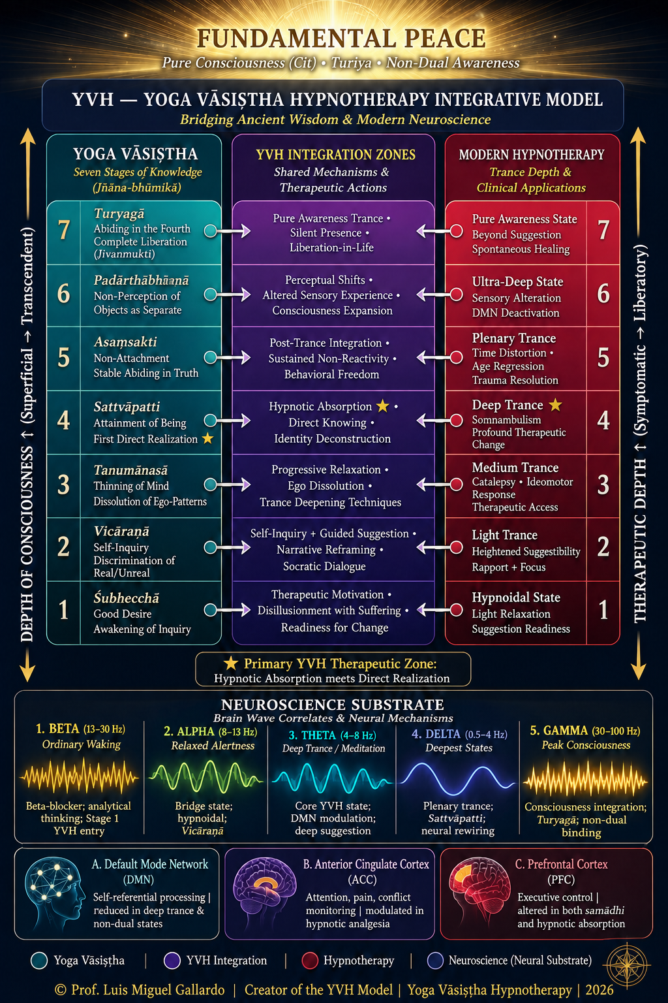
Reading the YVH model
HOW TO READ THE FIGURE
01
Seven jñāna-bhūmikās appear beside seven author-proposed trance depths.
VISUAL OVERVIEW
02
The middle column names shared mechanisms and therapeutic actions.
03
Level 4 marks the proposed primary therapeutic zone.
04
Fundamental Peace is the proposed endpoint; neuroscience is a hypothesized substrate.
Research heuristic
The figure proposes correspondence. It does not establish equivalence. Neural associations are correlational, and YVH has not yet been tested in clinical trials.
Figure © 2026 Luis Miguel Gallardo. Source: Gallardo (2026), Figure 1 and Section 10.5
11
Notes:
Read the figure as a proposed research map. Jñāna-bhūmikās are cumulative and retained; trance depth is state-dependent and reversible. The seven-fold structure comes from the Yoga Vāsiṣṭha, not from a standard seven-level hypnosis scale. Levels 6 and 7 are especially speculative. The neuroscience layer is correlational.
Source: Gallardo (2026), Figure 1 and Section 10.5. Original figure supplied by the author.

Slide 12
Fundamental Peace and the FP20
A proposed functional outcome
FOUR PROPOSED DIMENSIONS
Integrated regulatory capacity under changing conditions
Flexible attentional control
Emotional coherence across self-states
The paper links this profile to jīvanmukti at a functional level. A high score does not constitute liberation.
FUNDAMENTAL
PEACE
FP20
Reduced self-referential rigidity
Measurement status
The FP20 contains 20 items. Its psychometric development and validation for YVH remain ongoing.
Compassionate self-awareness
Sources: Gallardo and Chetri (2026); Gallardo (2026), Section 9.5
12
Notes:
Fundamental Peace is defined as a capacity, not as a pleasant mood. The proposed four components are attentional flexibility, emotional coherence, reduced self-referential rigidity and compassionate self-awareness. The link to jīvanmukti is functional rather than metaphysical. FP20 validation remains ongoing.
Sources: Gallardo and Chetri (2026); Gallardo (2026), Section 9.5; Slaje (2000); Fort (1998).

Slide 13
The proposed clinical pathway
Six phases are named in Section 10.2
SPECIFICATION NOTE
The abstract describes an eight-phase protocol. Reconcile this mismatch before validation.
1
2
3
4
5
6
Assessment
Psychoeducation
Induction and deepening
Therapeutic intervention
Integration and stabilization
Completion and follow-up
Clinical needs, goals and fit
Hypnosis and relevant concepts
Absorbed, receptive attention
Suggestion, narrative and inquiry
Daily-life practice
Consolidation and outcomes
Clinical scope
The pathway returns agency to self-hypnosis and self-inquiry. It remains a research proposal requiring clinical-hypnosis competence and Yoga Vāsiṣṭha literacy.
Source: Gallardo (2026), Sections 10.2 to 10.4
13
Notes:
Section 10.2 contains six named phases, although the abstract refers to an eight-phase protocol. This deck uses the named structure to avoid inventing a taxonomy. Intervention may include symptom-focused suggestion, narrative, self-inquiry, resource access and perspective shifts. The proposal requires clinical-hypnosis training, Yoga Vāsiṣṭha literacy, judgment and cultural sensitivity.
Source: Gallardo (2026), Sections 10.2 to 10.4.

Slide 14
Clinical boundaries and cultural integrity
AIM
Mokṣa and symptom relief remain different aims.
BELIEF
Hypnotic response requires no commitment to non-dual metaphysics.
SUGGESTIBILITY
Responsiveness is a capacity. It can reinforce conditioning as well as loosen it.
MENTAL HEALTH
Vairāgya must not be confused with depressive anhedonia or suicidality. Standard assessment remains essential.
CULTURE
Retain Sanskrit precision, include Indian scholarship and keep colonial context visible.
Disclosure: the author originated YVH, Fundamental Peace and FP20, and leads the World Happiness Foundation, publisher of this paper.
Source: Gallardo (2026), Declarations and Section 11
14
Notes:
These boundaries are load-bearing. The protocol must not conflate therapeutic benefit with liberation, require metaphysical belief, or let practitioner authority create dependence. Active depression or suicidality requires standard clinical assessment and care. The author disclosures should remain visible.
Source: Gallardo (2026), Declarations and Section 11.

Slide 15
Five testable hypotheses
H1
Efficacy after validation
After FP20 validation, test whether YVH improves scores more than an active relaxation control.
H2
Mediation
Test whether absorption and decentring mediate pre-to-post change beyond expectancy.
H3
Belief independence
Test whether response is moderated by prior metaphysical belief.
H4
Neural signature
Compare predefined neural outcomes after bhāvanā-guided versus standard inductions.
H5
Narrative comparison
Cūḍālā-style narrative outperforms matched direct suggestion on self-referential rigidity.
Before H1
Complete FP20 psychometric validation and preregister outcomes before efficacy testing.
Source: Gallardo (2026), Section 12.5. H1 and H2 are identified as priorities.
15
Notes:
H1 and H2 form the priority clinical programme. H4 is more expensive and less essential because a null neural result would constrain the mechanism story without necessarily falsifying clinical benefit. H5 tests the model's distinctive narrative contribution.
Source: Gallardo (2026), Section 12.5.

Slide 16
Selected reading and paper access
TEXT, HISTORY AND PHILOSOPHY
HYPNOSIS, NEUROSCIENCE AND OUTCOMES
Gallardo, L. M. (2026). The Supreme Yoga and the Science of Suggestion. WHF Research Lab.
Oakley, D. A., & Halligan, P. W. (2013). Hypnotic suggestion: Opportunities for cognitive neuroscience. Nature Reviews Neuroscience, 14.
Slaje, W. (2000). Liberation from Intentionality and Involvement. Journal of Indian Philosophy, 28.
Jiang, H., et al. (2016). Brain Activity and Functional Connectivity Associated with Hypnosis. Cerebral Cortex, 27.
Venkatesananda, S. (1993). Vasiṣṭha's Yoga. SUNY Press.
Wolf, T. G., et al. (2022). Functional Changes in Brain Activity Using Hypnosis: A Systematic Review. Brain Sciences, 12.
Roberts, M. A. (2016). Abbé Faria: From Lucid Sleep to Hypnosis. American Journal of Psychiatry, 173.
Rosendahl, J., et al. (2024). Meta-analytic evidence on the efficacy of hypnosis. Frontiers in Psychology, 14.
Ernst, W. (1995). ‘Under the influence’ in British India. Psychological Medicine, 25.
Gallardo, L. M., & Chetri, S. (2026). Hypnosis as a Mechanism of Emotion Regulation and Self-Integration. Behavioral Sciences, 16.
Full paper
https://doi.org/10.68220/whf.2026.001
luismiguel@shooliniuniversity.com
The paper's complete bibliography contains 90 numbered references. Licence: CC BY 4.0.
16
Notes:
Selected references only. See the paper for the complete 90-item bibliography. Full paper DOI: 10.68220/whf.2026.001. Licence: CC BY 4.0.
Background illustration: original image generated for this presentation.

